Slide 1
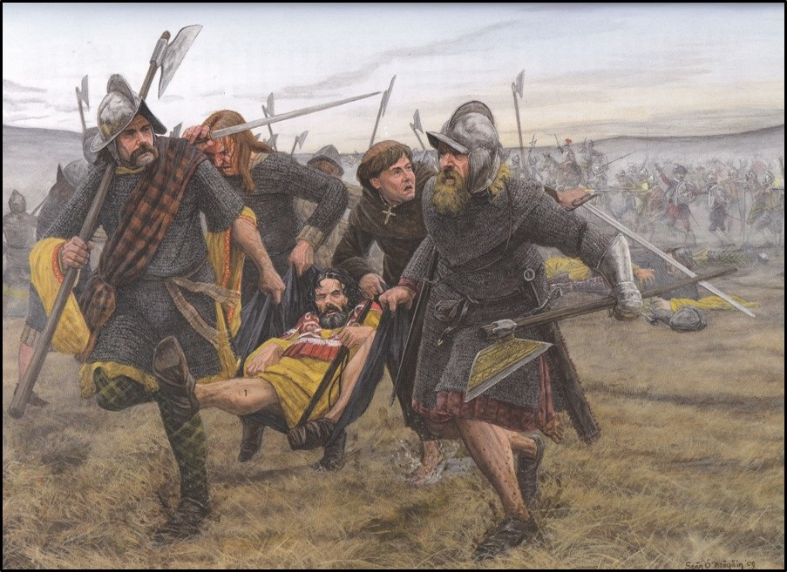
Battle of The Bloody Bank
July 1401 AD
David McIlreavy BA MA MA MIAI,
Project Director
The Medieval Bray Project

Slide 2
The Lead Up to The Battle of The Bloody Bank
AD 1399 – 1401

Slide 3
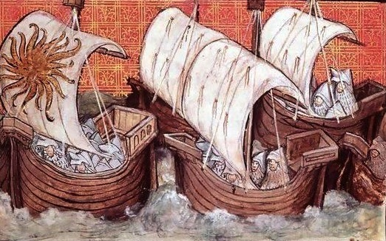
Richard II’s Irish campaign
AD 1399
The situation surrounding the Irish lordship had been deteriorating for some time, but in July AD 1398 the Lord Lieutenant of Ireland, Roger Mortimer, 4th Earl of March and 6th Earl of Ulster, was killed at Kells by Gaelic Irish forces.
With such an act demanding a response, and Art Mac Murrough, king of Leinster openly in arms against the king, Richard II landed in Waterford on 2 June AD 1399 at the head of an army of up to 40,000 including archers, men at arms, knights and almost 3,000 sappers.

Slide 4
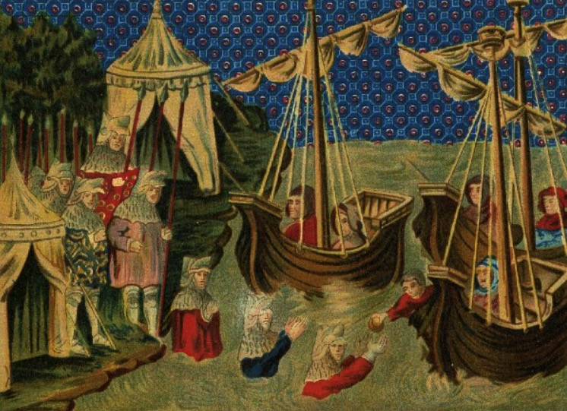
The unravelling of the royal campaign
However, the royal expedition rapidly became undone by MacMurrough’s ability to retreat into the Wicklow Mountains.
A guerrilla style campaign almost inevitably developed, with the Gaelic Irish slowly picking off parts of the royal army, whilst severely curtailing their ability to forage.
At one point Richard’s soldiers were even forced to wade out to supply vessels off the Arklow coast in search of bread.

Slide 5
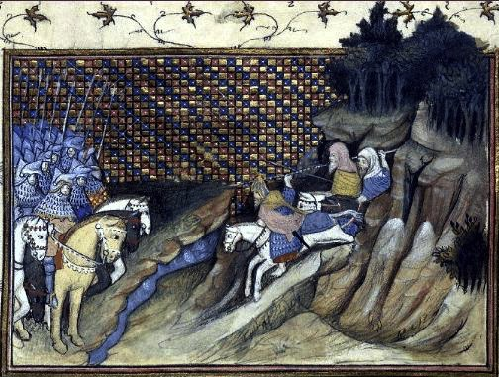
Royal departure
Finally, the landing of Henry Bolingbroke in Yorkshire during the campaign, forced Richard return to England, leaving the Gaelic Irish as one eye witness notes - “as bold as lions”.
Richard left Dublin on 3rd August AD 1399.
In the aftermath of the royal departure, the Lord Lieutenant Thomas Holland, 1st Duke of Surrey, 3rd Earl of Kent was tasked to prosecute the remainder of the campaign.
However, at the parley depicted here, Art MacMurrough and his O’Byrne kinsman Domhnall O’Byrne denounced Richard and any offer of peace.

Slide 6
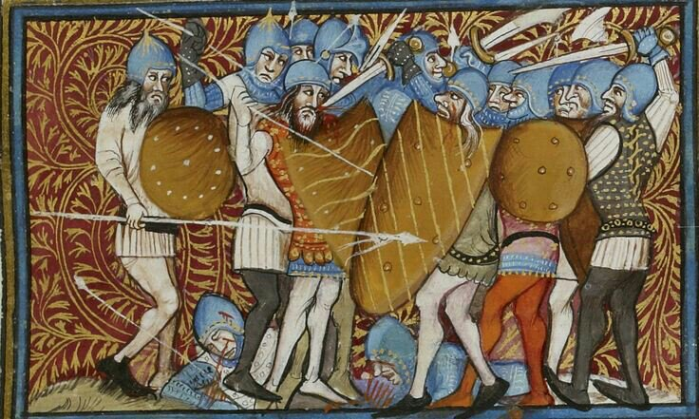
The Irish lordship under Henry IV
In October 1399 Richard II was formally deposed from his royal title and Henry IV was declared King of England, France and Lord of Ireland. However, a letter from the Irish council after his accession states:
‘The English marchers are not able, nor are they willing to ride against them [the Irish] without stronger paramount power…the land is in danger of final destruction’

Slide 7
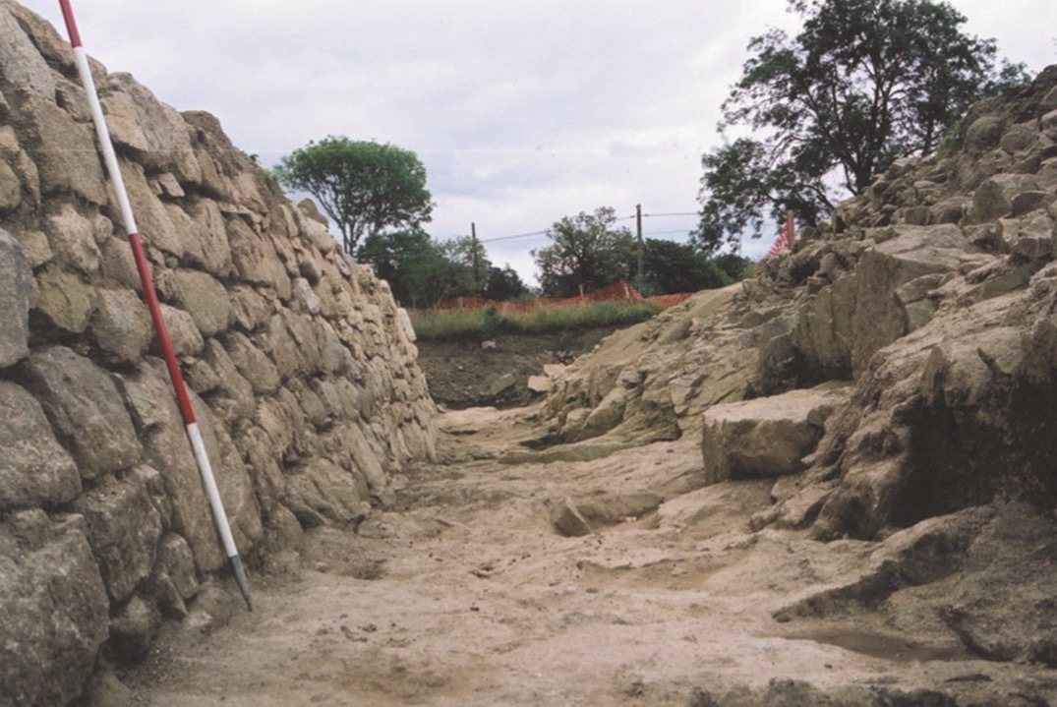
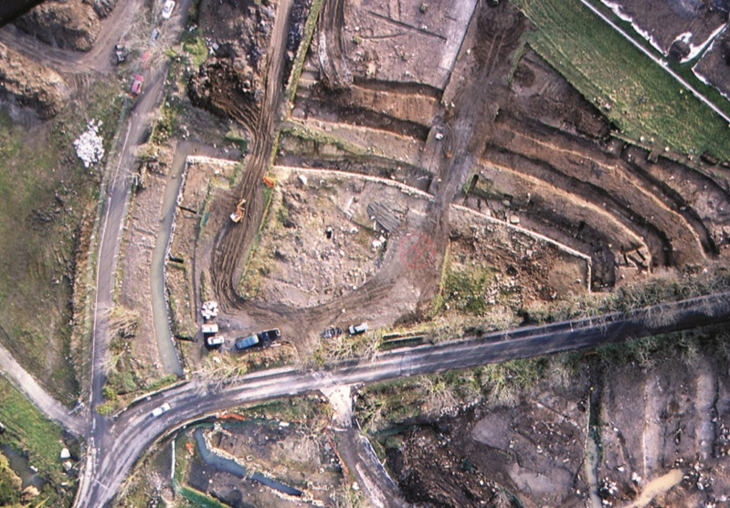

Slide 8
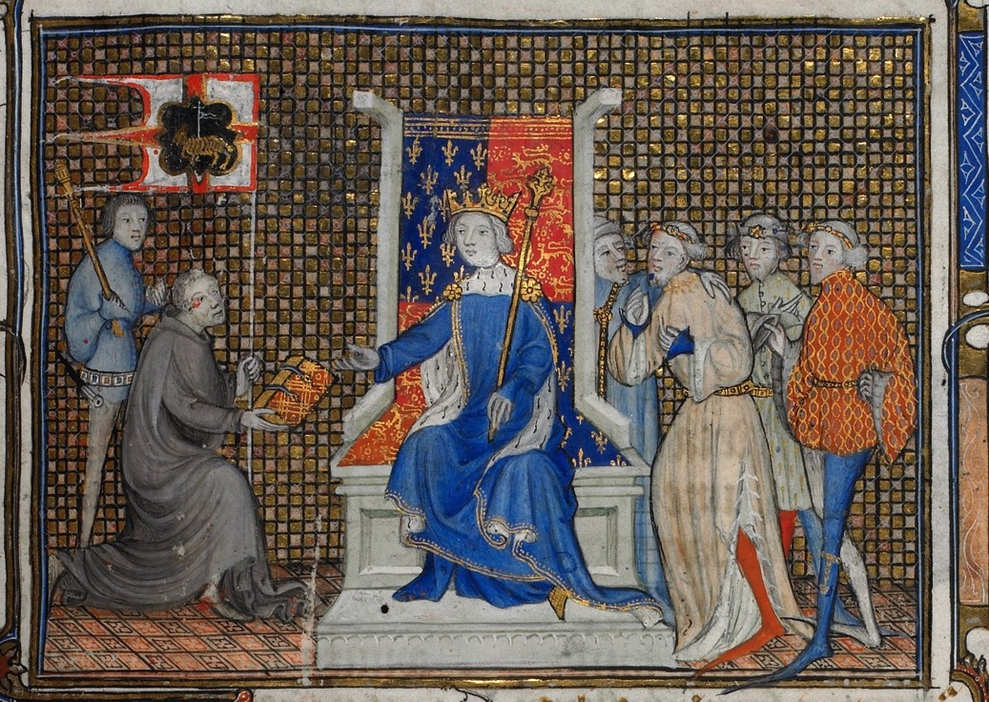
Re positioning the O’Byrnes
Whilst it may be true to say that the heartland of the O’Byrne’s lay in the Wicklow Mountains, the situation by the mid 14th century saw the extended dynasty controlling large swathes of terriory on the fringes of the Irish lordship.
In particular, Wicklow town fell under their ‘protection’ and provided an important introduction to the materiale of the wider Plantagent empire.
Not content to be passive receptors of this empire, we find individuals like Donnchadh mac Braen at Richard’s court, and on campaign in 1396 AD.

Slide 9
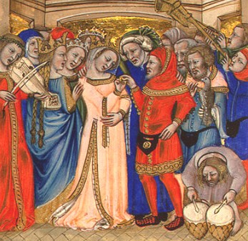
Re positioning the O’Byrnes
And this re positioning can be seen in the decisive marriage of O’Byrne to various O’Meagher women from Tipperary.
These women brought valuable dowries, not least in the form of gallowglass warriors. But, these warriors whilst valuable assets were still mercenaries and demanded continued payment for their services.
Whilst billets and raiding satisfied in the medium term, what the mercenary craved above all was land.

Slide 10
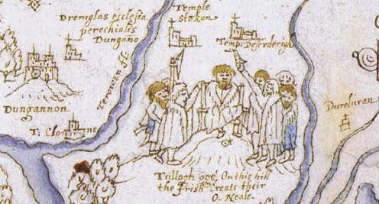
Irish expansions
Within this environment of expansion and repositioning, Richard II’s departure from Ireland, and his subsequent deposition, had generated new opportunities for the Gaelic Irish which the latter were not slow to recognise.
Art MacMurrough’s continued involvement in the feud between the Earls of Ormond and Desmond provided access to blooded warriors, and even alliance with disaffected English on the fringes of the lordship.
Even beyond Leisnter, forces under Niall Og O’Neill had assembled, threatening to march on Dublin to free his relatives.

Slide 11
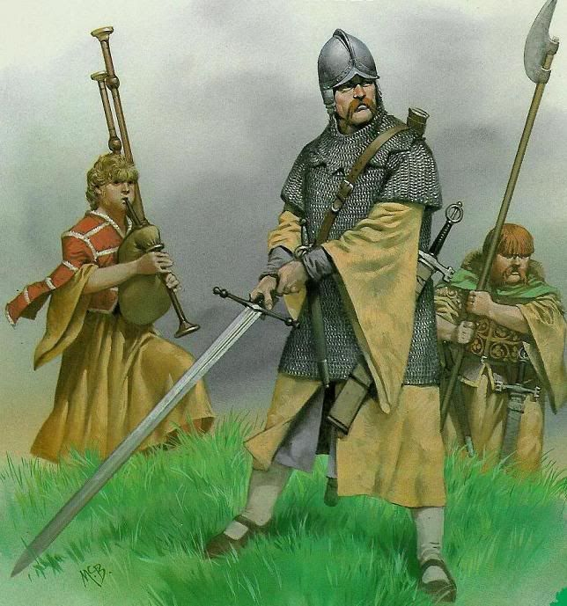
The O’Bryne ‘landnam’
AD 1401 saw the O’Byrne dynast Domhnall make their move, backed by Art MacMurrough himself, and their gallowglass relations from Tipperary.
Atrt MacMurrough assaulted Wexford, whilst the O’Byrnes took the royal castle of Newcastle McKynegan during the same expansion. In a demonstration of their commitment to further gains, the O’Byrnes then settled the O’Meagher mercenaries just south of Bray.
This settlement was a direct threat to the heartland of the Irish lordship, but Bray and in particular its castles at Great Bray and the forerunner of Oldcourt, stood in the way of further advancement.

Slide 12
The Forces of The Bloody Bank
July AD 1401

Slide 13
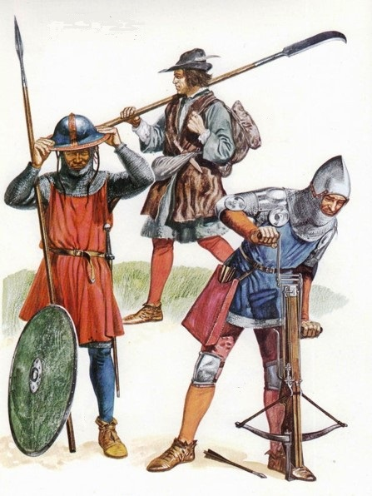
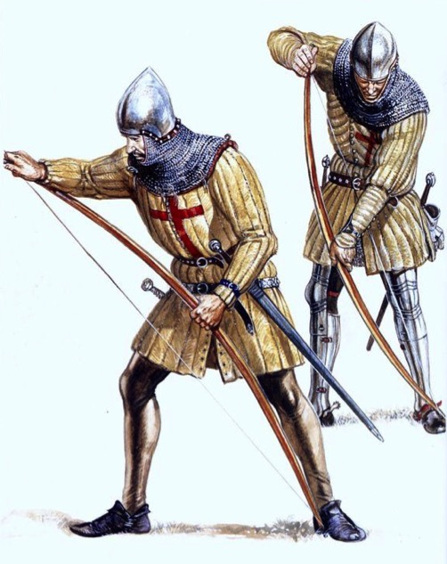
The Pale forces - Dublin
Dublin may already have been on alert given the settlement of mercenary forces south of Bray, and a force may already have been in the process of being assembled.
The Dublin forces were under the command of the mayor John Drake, and in the main consisted of peasant levies, but both spearmen and crossbowmen/archers would have been available in reasonable numbers.

Slide 14
The Pale forces - Dublin
It is important to remember that under the Assize of Arms of 1252 required that all "citizens, burgesses, free tenants, villeins and others from 15 to 60 years of age" should be armed. The poorest of them were expected to have a halberd and a knife, and a bow if they owned land worth more than £2.
This would have given Drake a potential baseline force in the region of possibly 2000 individuals, although actual muster figures are hard to definitely determine.
And certainly the humble bowman should not be disregarded, as by this period drawstring pulls could be between 100-185 lbs, which when teamed with bodkin tipped arrowheads were more than capable of punching through plate armour.
Even the psychological shock of facing a disciplined force of English archers cannot be discounted.

Slide 15
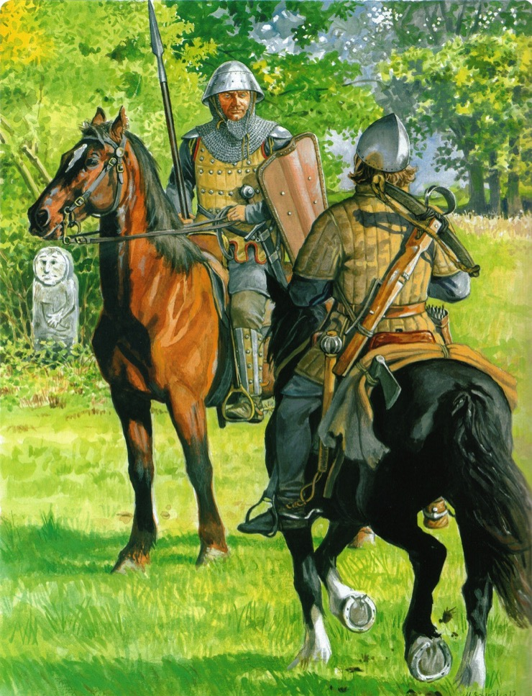
The Pale forces – Marcher
The marcher forces at Carrickmines may have provided the main ‘military grade’ backbone of the Pale forces.
In particular the holebar trooper featuring a light horse primarily intended to transport a soldier to the battle lines, rather than to participate in a charge.

Slide 16
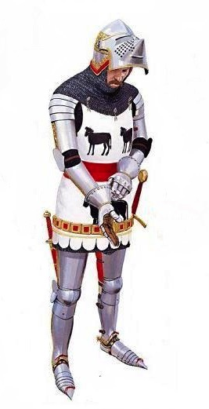
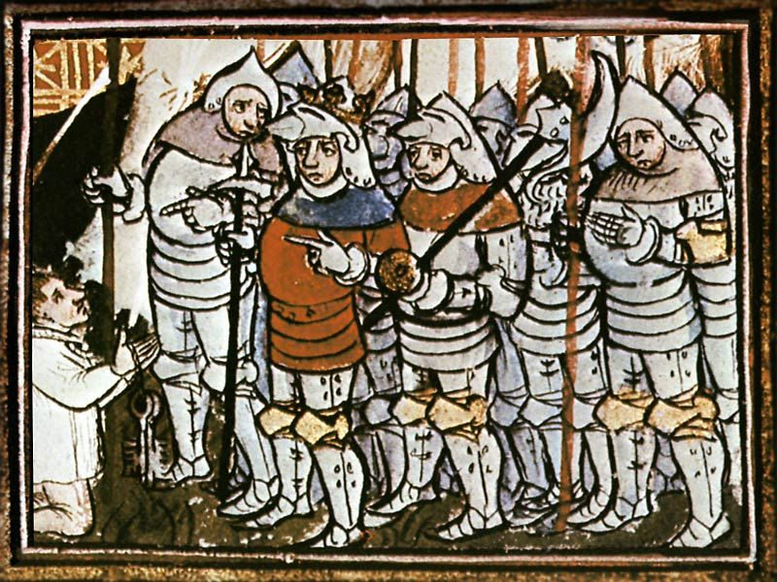
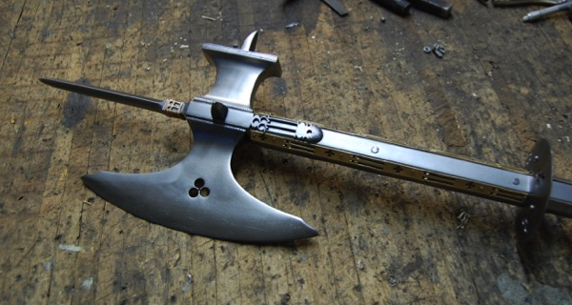
The Pale forces – Marcher and Knights Hospillars
The higher echelon of these forces would have comprised professional soldiery in plate armour.
These knights generally fought on foot, favouring weapons such as the poleaxe in addition to the more traditional sword.
The addition of forces from the Knights Hospitallers forces from their preceptory at Ballyman would have provided a hard military core to the force.

Slide 17
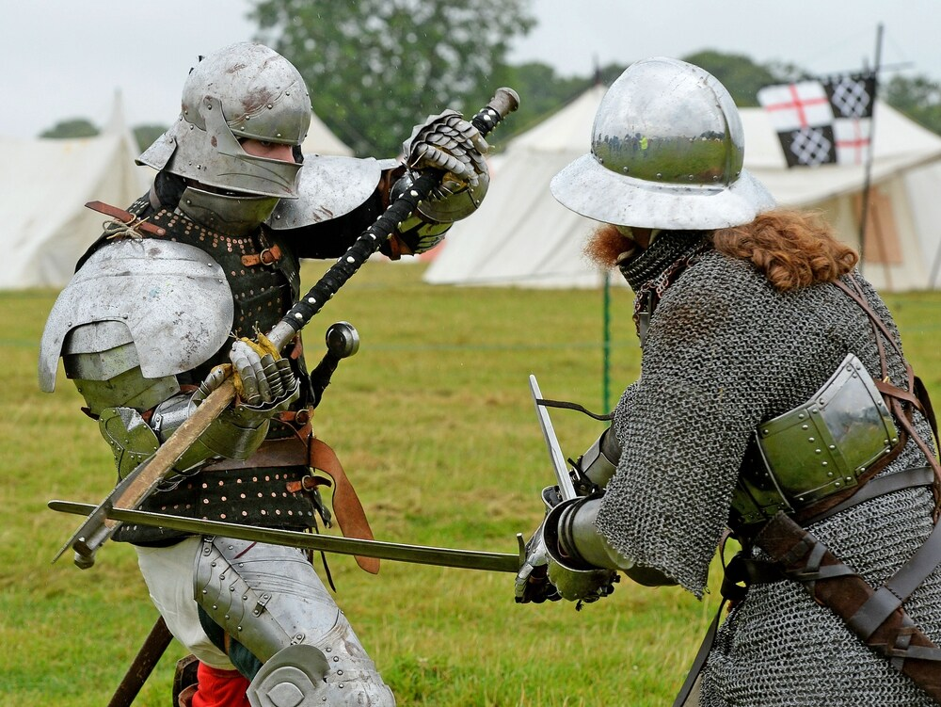

Slide 18
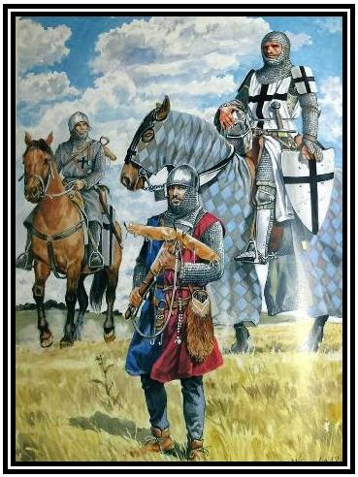

Slide 19
Plantagenet deployment
The deployment of traditional Plantagenet armies has been discussed by works such as Alfred Byrne in ‘The Crecy War’ (1991) where dismounted knights in the centre, flanked by archers and cavalry. The latter were intended to harry the flanks of any force, using the dismounted armoured centre as the main punch.
If Drake’s force reached a potential 2000 drawn from the immediate environs of Dublin, with Marcher lord forces and Hospitallers this could have reached 3000.
However, the deployment of such a force may have been relatively ad hoc given the range of individuals, and we have little idea of what intelligence the Pale forces had on the O’Byrnes/O’Meaghers prior to engagement.

Slide 20
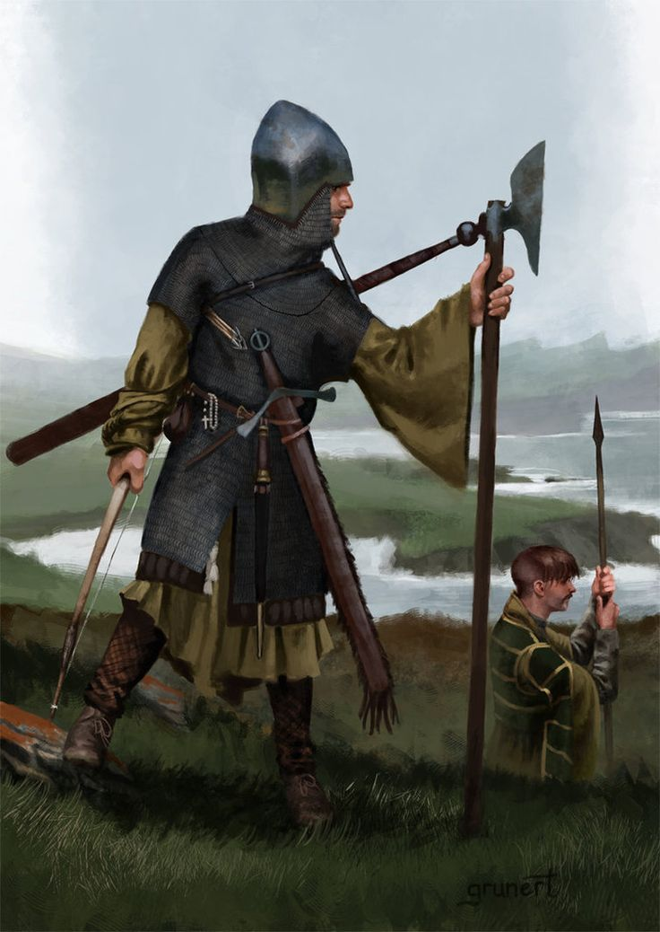
The O’Byrne/O’Meagher force
The lowest estimate puts the death toll on the O’Meagher side at 500 ‘all men of warre’. However, the highest elements suggest in the region of 4,000.
The backbone of this force may well have been gallowglass, with their attendants and associated kern.

Slide 21
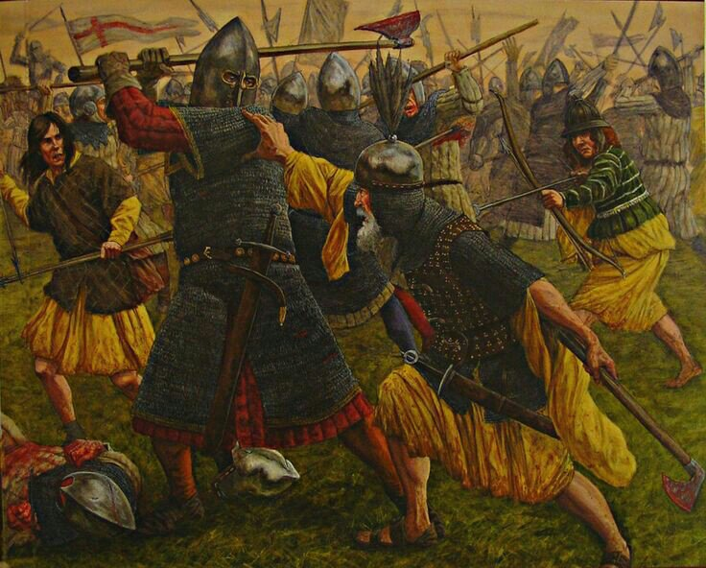
Gaelic Irish numbers
If we use comparable dowries which involved gallowglasses, then 200 would seem a reasonable core number (probably 2 battalions)
These ‘core’ gallowglass would have been attended by kern and ‘trainees’, which would make a number of 2000 O’Meagher more than reasonable.
Add the inevitable O’Byrneand any disaffected English involvement, and a force of some 3000-3500 may be considered a conservative estimate.

Slide 22
Reconstructing the Battle
July AD 1401

Slide 23
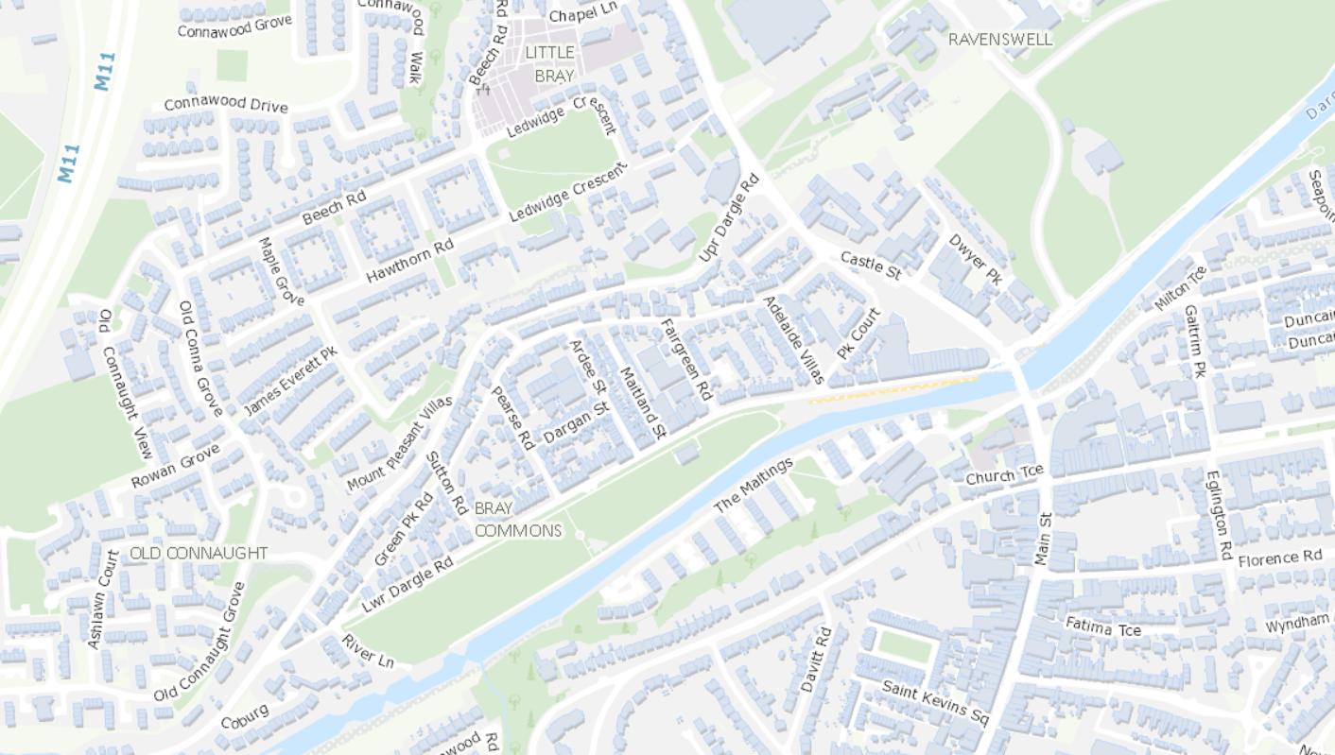
The Bloody Bank

Slide 24
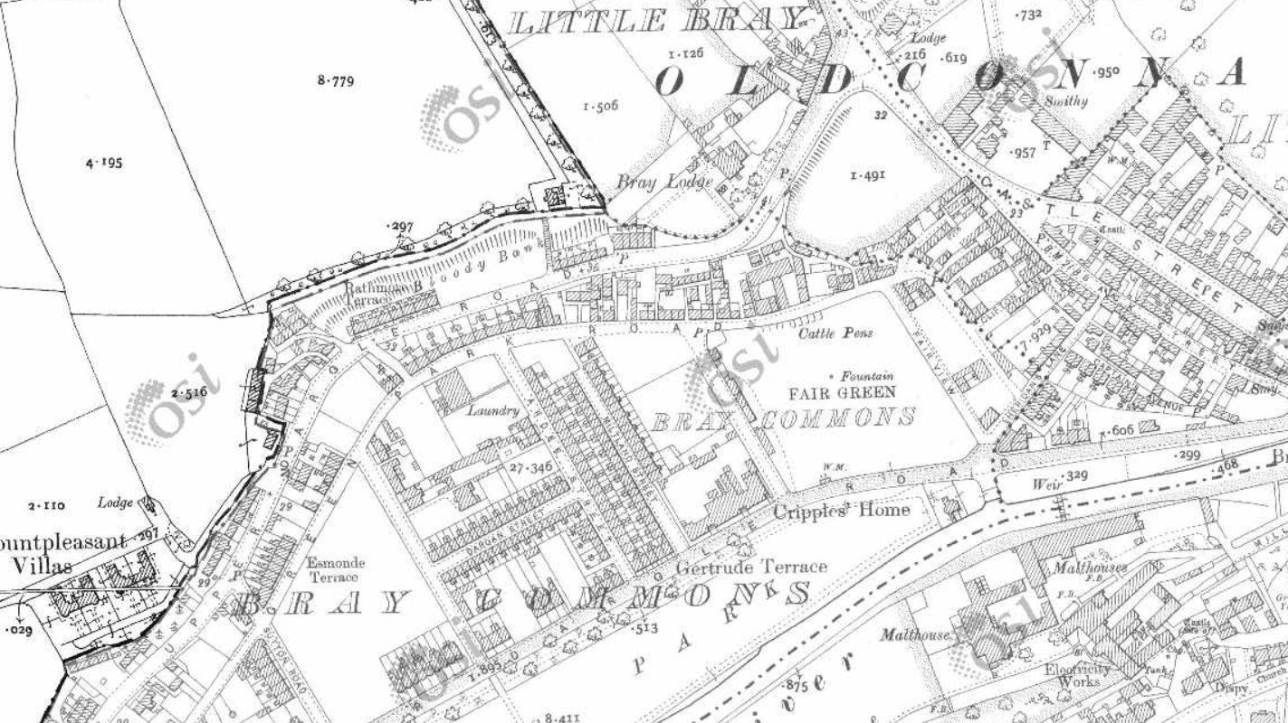
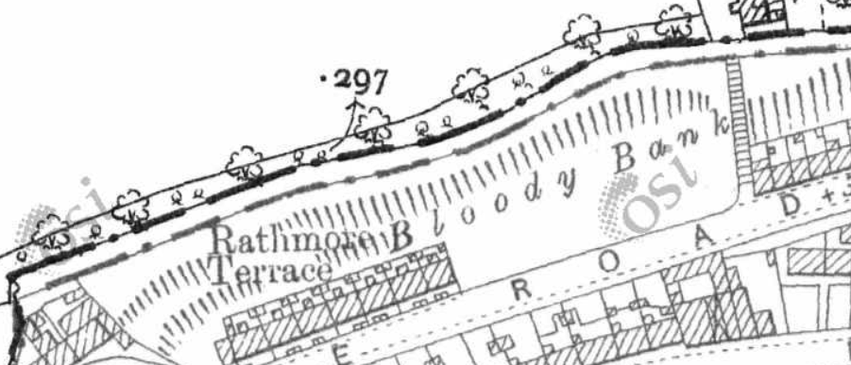
The Bloody Bank

Slide 25
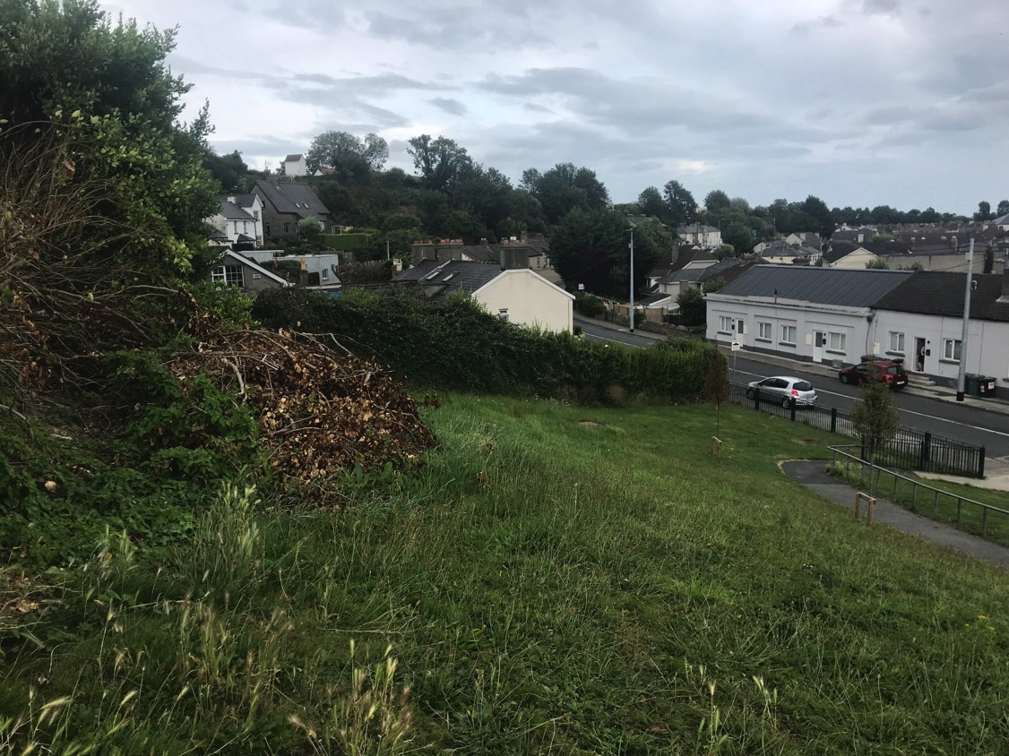
The Bloody Bank

Slide 26
Reconstructing the Battle
Key to reconstructing the battle is an identification of what exactly the aim of the engagement was for the Irish forces.
It is my contention that the force was too large to be a simple raiding party, and therefore the real aim may have been to add Bray to their territorial posessions. So why Little Bray?
The Irish forces may well have been attacked Little Bray as a lightly defended target intended to either draw out the forces of Great Bray and Oldcourt castles, or to provoke a surrender. If Bray could be persuaded to enter the O’Byrne posessions then the road to Dublin was open.
However the size of the force may have been a contingency plan. If Bray was to be assaulted over the river and on the slopes under the present St Paul’s church, the attrition would have been significant.

Slide 27
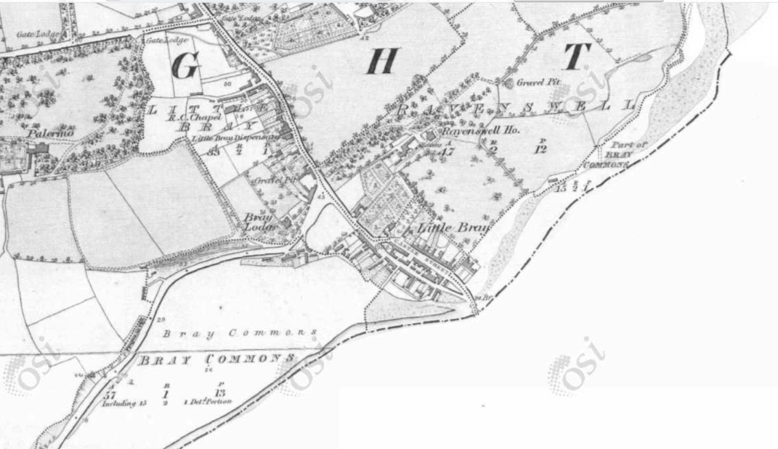
Surrounding the O’Meagher forces
We must assume that the Irish forces would have been in the process of looting and firing Little Bray when the Drake led army arrived.
The Pale forces, advancing down the Dublin road, could easily have surrounded the settlement of Little Bray from both the north and east.

Slide 28
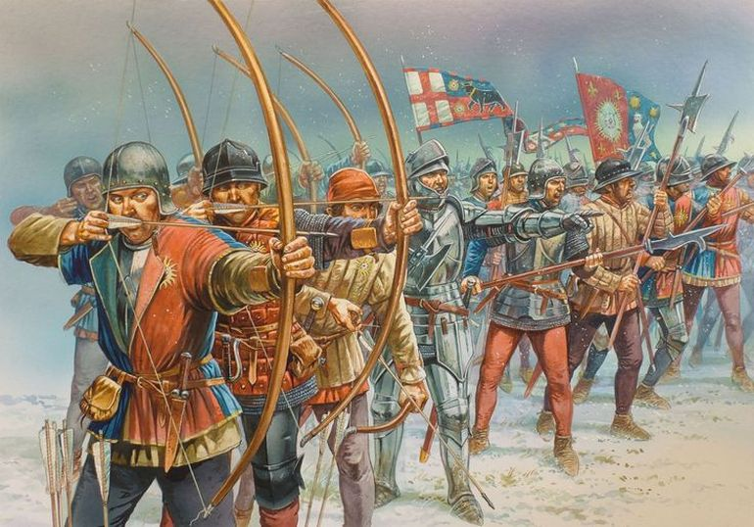

Slide 29
Springing the trap
Under longbow and crossbow pressure, the Irish forces could have been pushed out of Little Bray proper, and to the west, all the while sustaining losses.
Given that the main Irish force is confined to the Bloody Bank, not simply retreating to the west, it may be surmised that a detachment of the Pale forces had established a blockade at the western end of the modern People’s Park.

Slide 31
Springing the trap
With this trap sprung the Irish would have been forced to make a stand on the slopes of the Bloody Bank.
A massacre was almost inevitable….

Slide 32
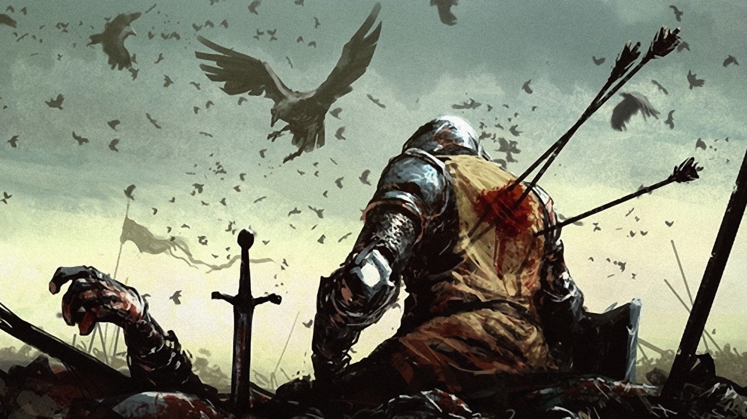

Slide 33
The Aftermath

Slide 34
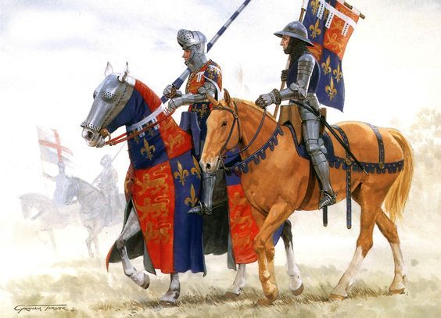
The Lancastrian Lieutenancy
In the aftermath of the engagement Sir Stephen le Scrope, deputy to the new Lord Lieutenant, arrived in in Ireland.
Thomas of Lancaster, 1st Duke of Clarence, the new Lieutenant of Ireland for his father Henry IV arrived in November, and received the submission of Domhnall O’Byrne -
‘to be a faithful liege to the king and to conduct himself faithfully towards the king’s people’

Slide 35
The O’Byrne pledges
Not to rise up with enemies or rebels of the king, but to serve the king against them.
Not to harbour any who would rise against the king, with a pledge of 100 marks against the delivery of the rebel’s head or body to the lieutenant or justice of the peace.
To permit the king and his subjects full enjoyment of the ‘woods, lands, meadows and pastures belonging to the New Castle of McKyngngham’
To allow the lieutenant or justices of the peace to adjudicate on any wrongs committed against O’Bryne’s people, including a cessation of all forced reparations on march inhabitants

Slide 36
The deterioration of the Lieutenancy
However, within six months of the O’Byrne pledges to the Duke of Clarence, the ability of the lordship as an enforcing agency continued to deteriorate.
‘… your son is so destitute of money that he has not a penny in the world, nor can borrow a single penny, because all his jewels, and his plate, that he can spare of those which he must of necessity keep, are spent and sunk in wages…’
‘…his soldiers are departed from him, and the people of his household are on the point of departing…’.

Slide 37
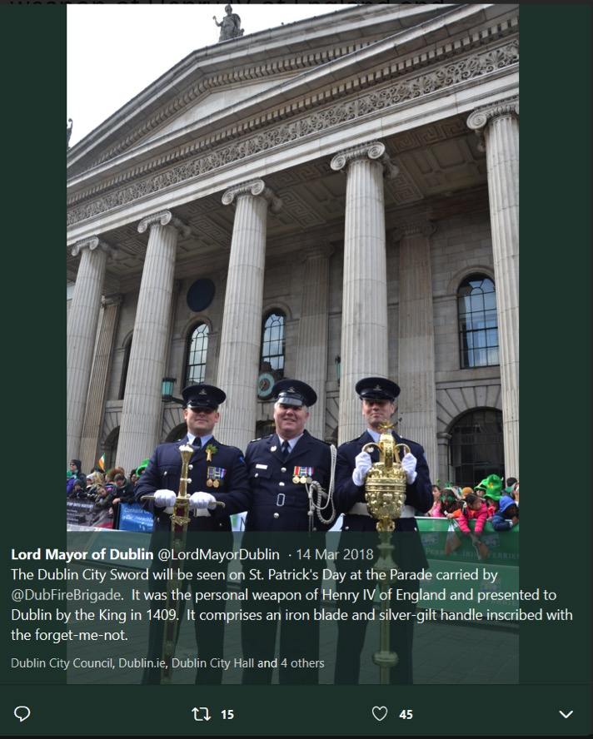
Recognition of the Pale forces
However, the forces under Mayor Drake did gain some recognition of the Irish defeat. Henry IV granted the mayoral office a personal weapon in 1409 AD to be carried before them on state occasions to remember the battle.
This sword is still in possession of the mayoral office in Dublin today.

Slide 38
Commemorating the Battle

Slide 39
Commemoration
The battle, or more properly rout, of Irish forces on the Bloody Bank has largely been forgotten. The Victorian sanitisation of the name’ Bloody’ to ‘Sunny’ has in no small way helped to assist in its loss in Bray’s history.
But the battle or rout is an extremely important event in the later medieval history of Bray, and in the wider area.
So, The Medieval Bray Project are looking for ideas from the wider community….

Slide 40
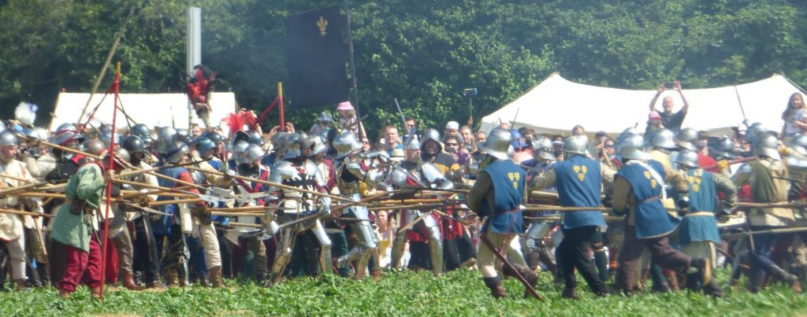

Slide 41
www.themedievalbrayproject.ie
https://www.facebook.com/themedievalbrayproject/

